Slide 1
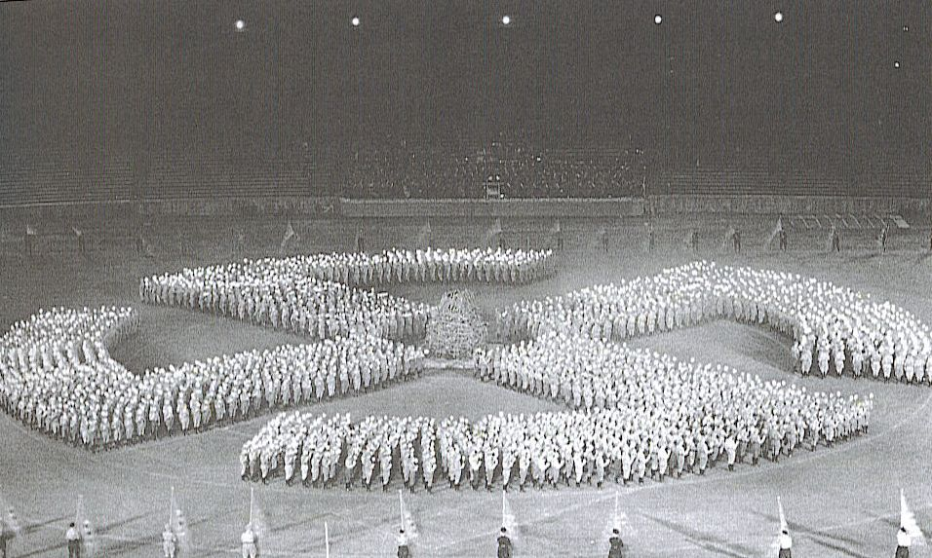
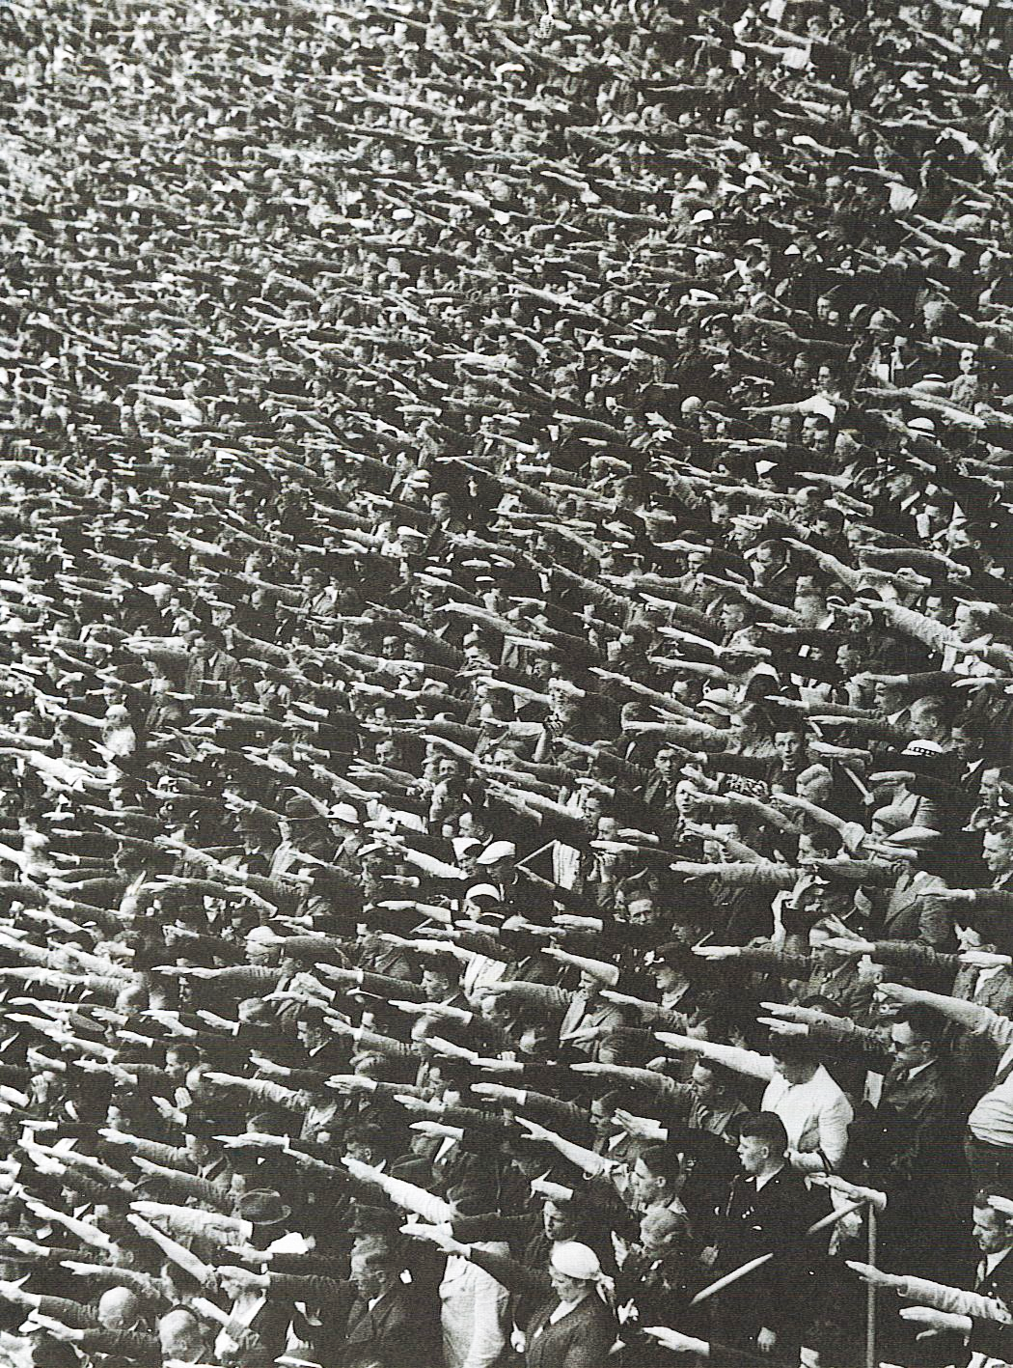
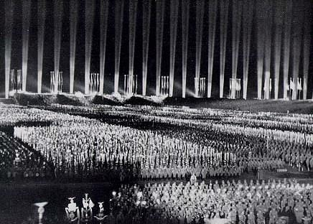
Q: How did the Nazis maintain control?
Propaganda Image : Order & Power

Slide 2
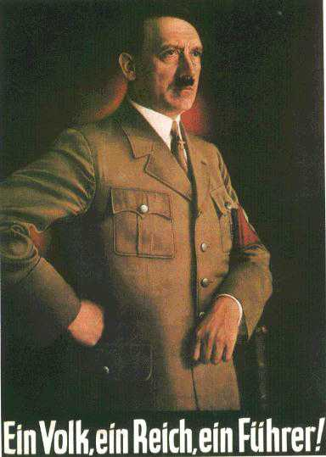
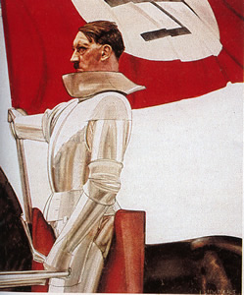
Propaganda Image : Order & Power
. . . and a Führer who worked tirelessly for the good of the nation

Slide 3
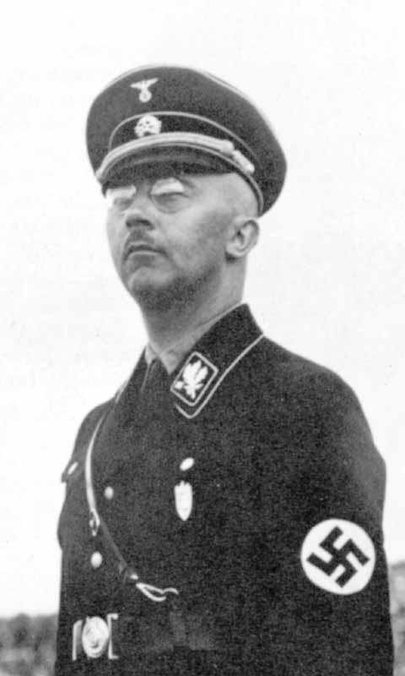
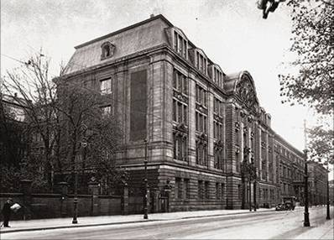
Secret State Police (Gestapo)
Prinz-Albrecht Str. 8
Heinrich Himmler: Head of German Police and of the S.S.

Slide 4
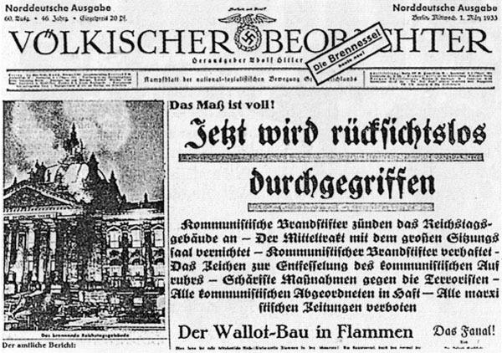
Control of the Press (more propaganda)
People's Observer:
Newspaper of Nazi Party from 1920.
25 years - produced effective propaganda.
Blamed Jews for everything
Blaming the Jews for the Reichstag fire

Slide 5
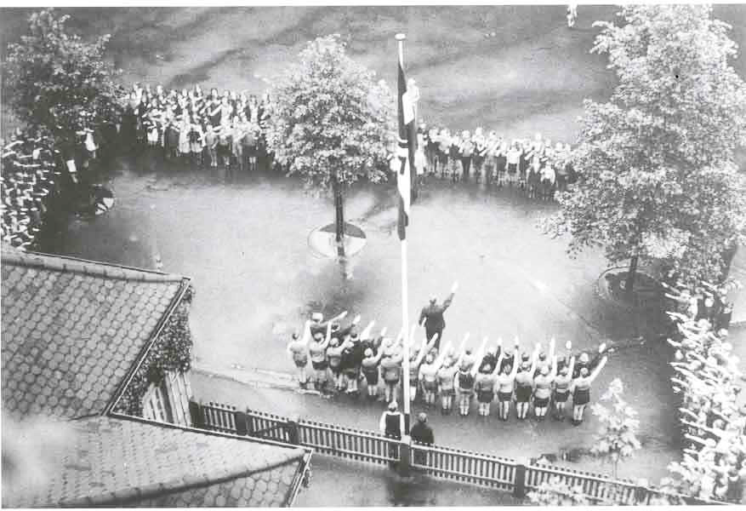
Control of Education

Slide 6
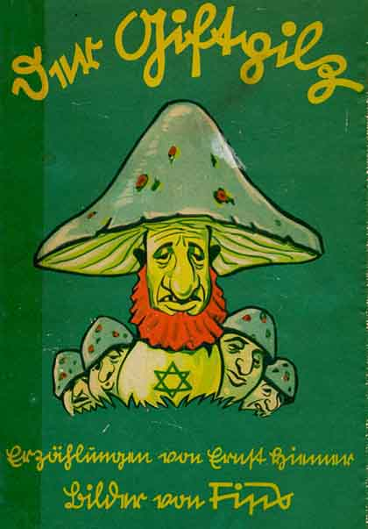
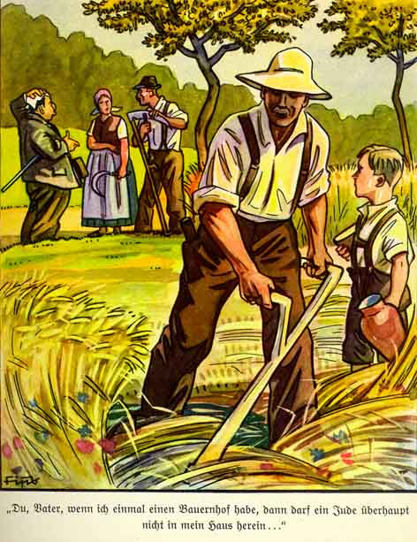
Indoctrination of the Young
“Once you have a farm, a Jew may not enter”

Slide 7
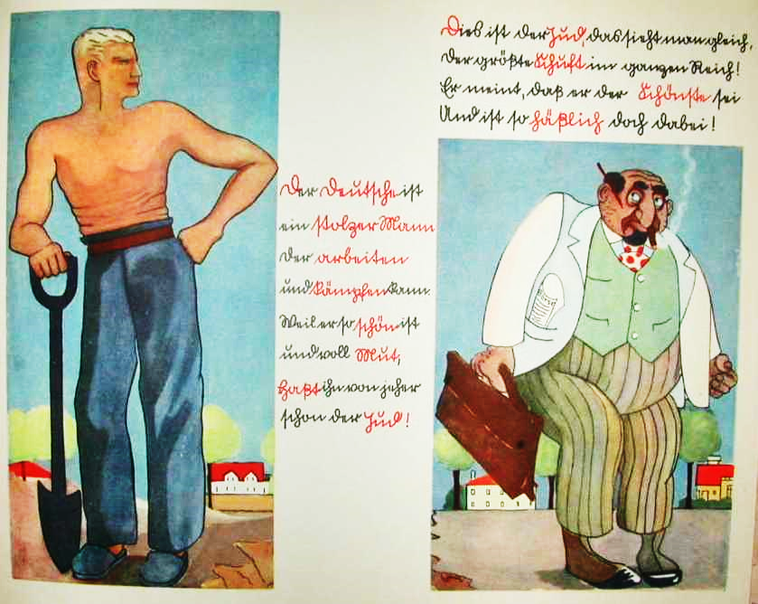

Slide 8
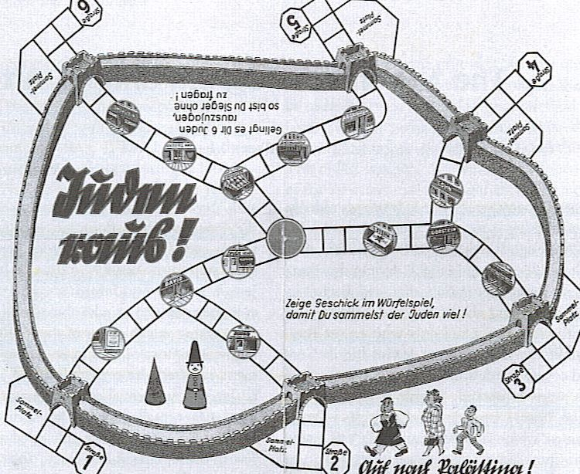
“Show skill in the game of dice so that you collect a lot of Jews.” (Meaning you remove them from the board.)

Slide 9
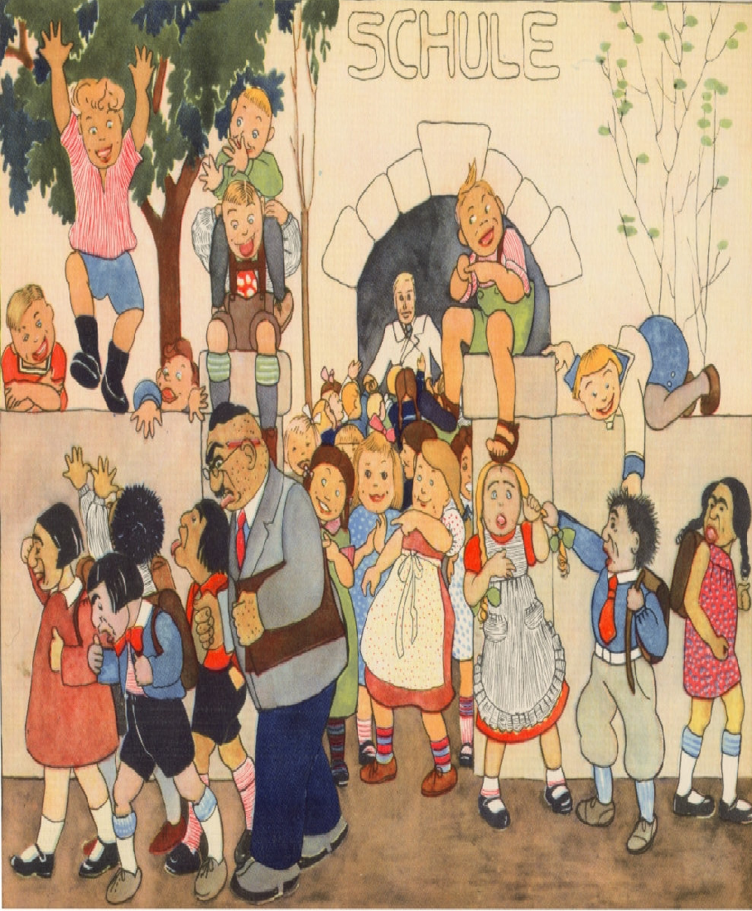
From Anti-Semitic Children’s Books
“It will be fine in school at last,
For all the Jews must leave.
For big and small it’s all alike.
Anger and hats do not avail
Nor utmost Jewish whine or wail.
Away with all the Jewish breed.
‘Tis the German teacher we desire
Now he leads the way to cleverness,
Wanders & plays & laughs
So going to school is quite a joy.”

Slide 10
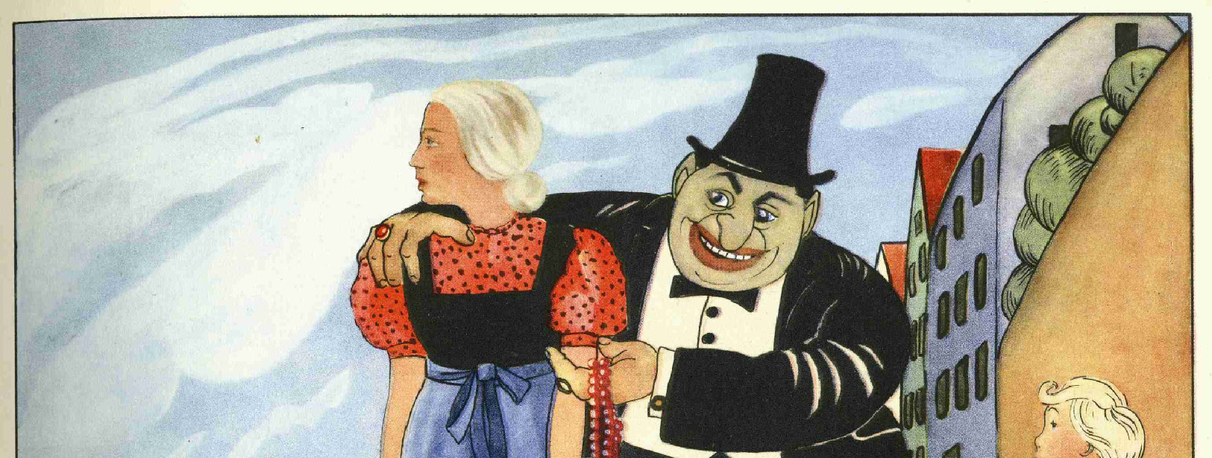
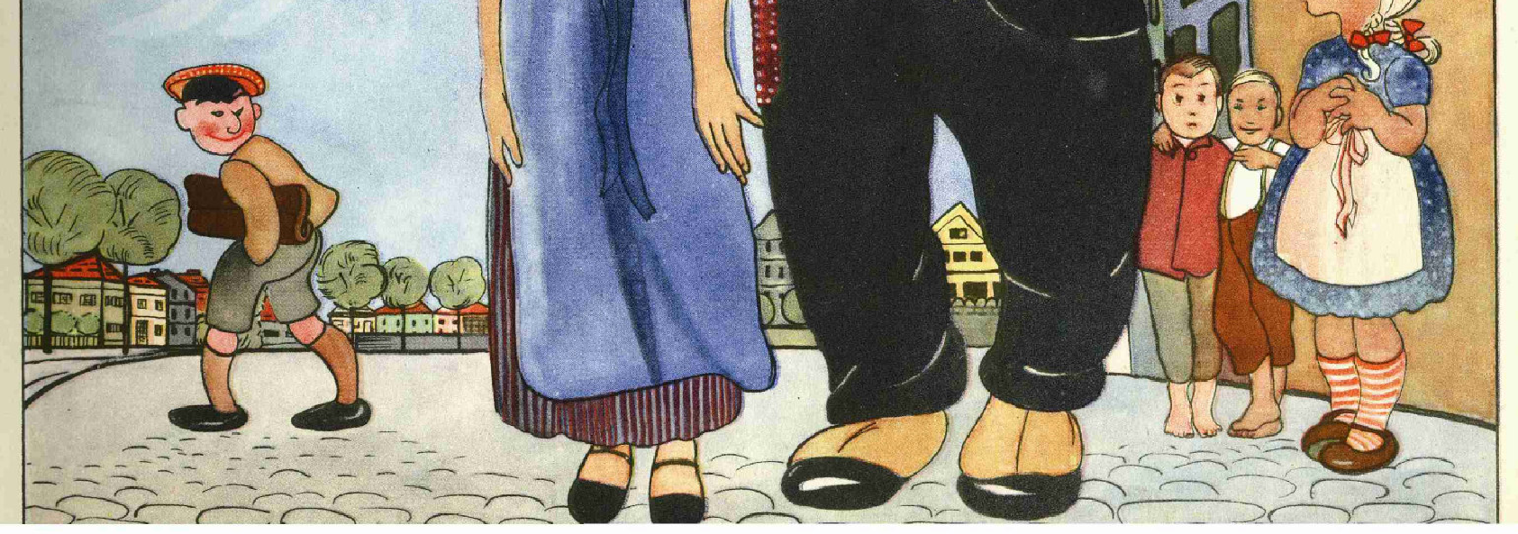
“What a creature is the Jew.
Not even his own women he likes.
To share himself a German wife.
He thinks just cute. You bet your life!
Look at Jews and girl right here:
‘Tis sure he can’t be thought her peer!
Compare him with this German Frau.
He cuts a pitiable figure now!
I would the Jew had sense to own
He’d best leave German girls alone.
Try his own “kalle” (kind) instead.”

Slide 11
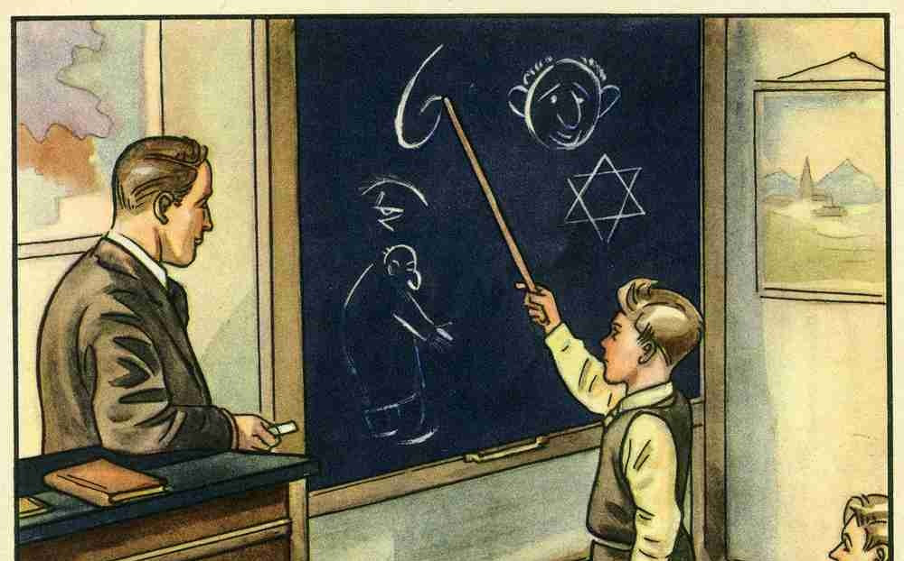
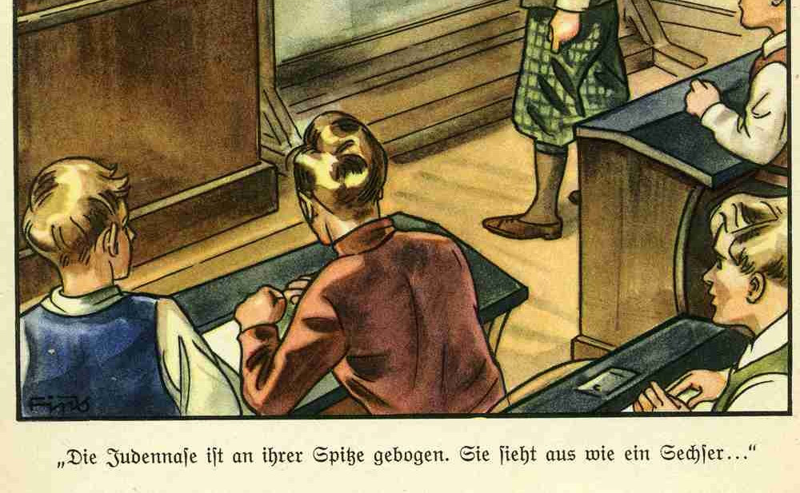
How To Tell A Jew
“The Jewish nose is bent at its point. It looks like the number six.
From a Jew’s face the wicked devil speaks to us.
The Devil who, in every country, is known as an evil plague.
Would we from the Jew be free,
Again be cheerful and happy?
Then must youth fight with us
To get rid of the Jewish Devil.”

Slide 12
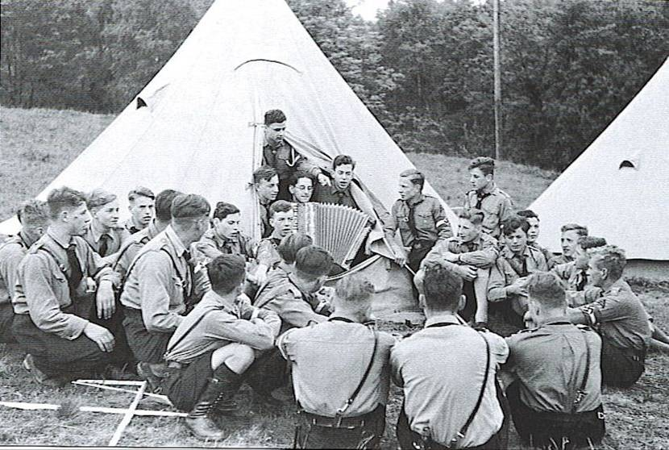
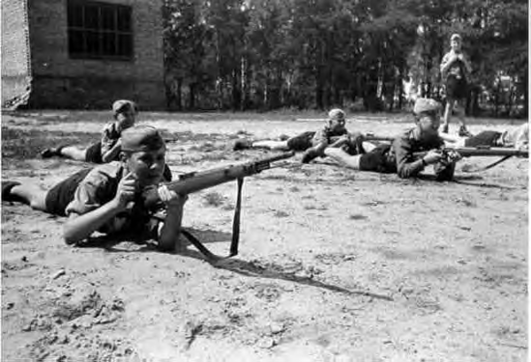
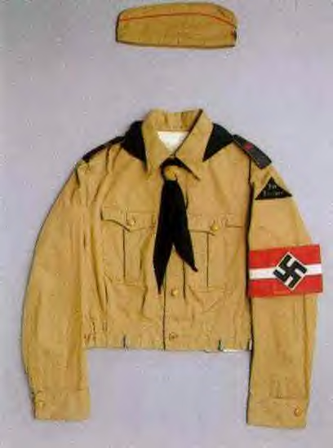
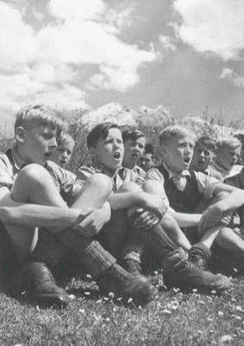
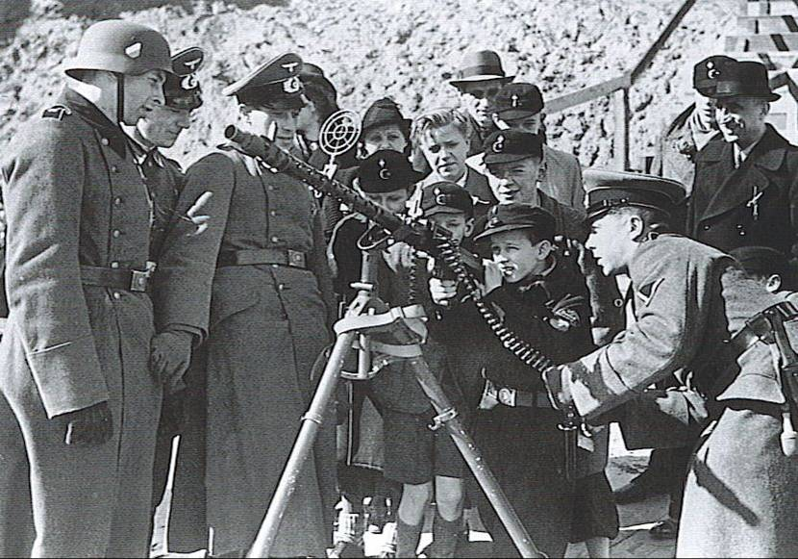
Hitlerjugend
(Hitler Youth)

Slide 13
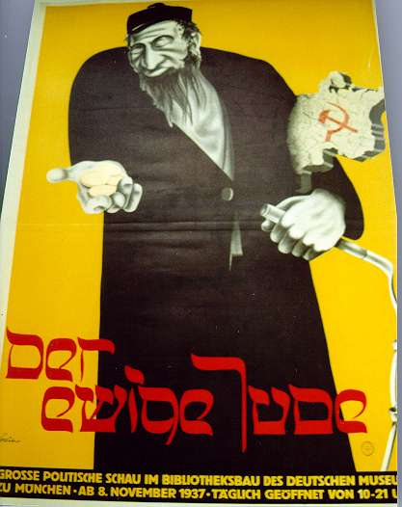
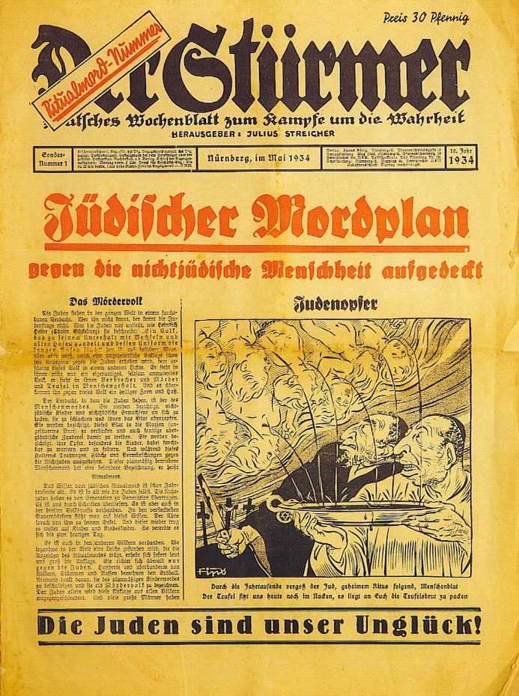
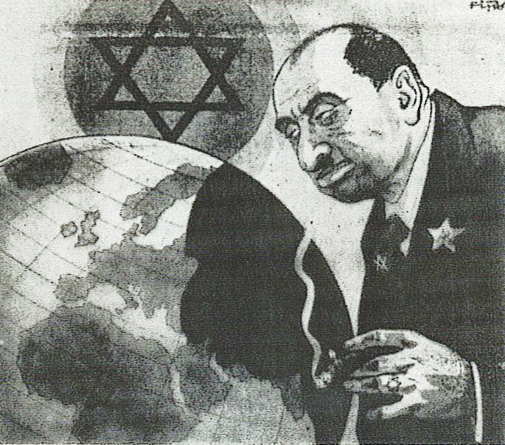
Media influence:
Magazines
Advertisements
Newspapers
Radio
Gov’t flyers
“Jewish Murder Plan”
“The eternal Jew”
"The Jews are our unhappiness!"

Slide 14
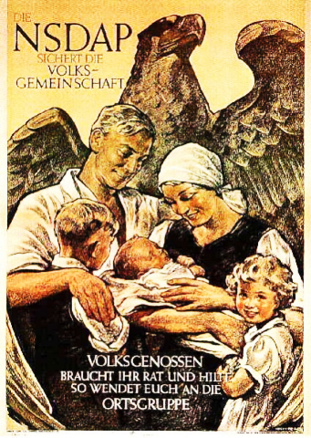
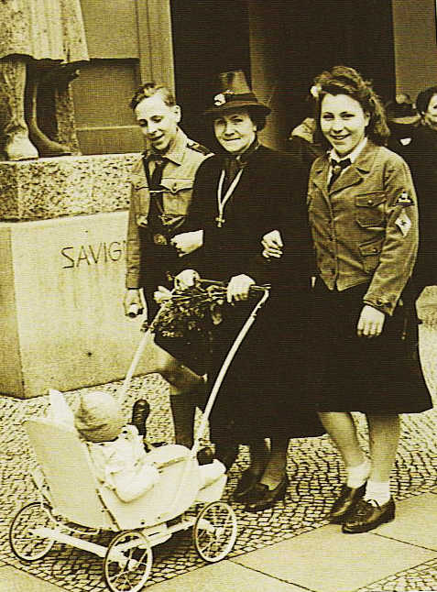
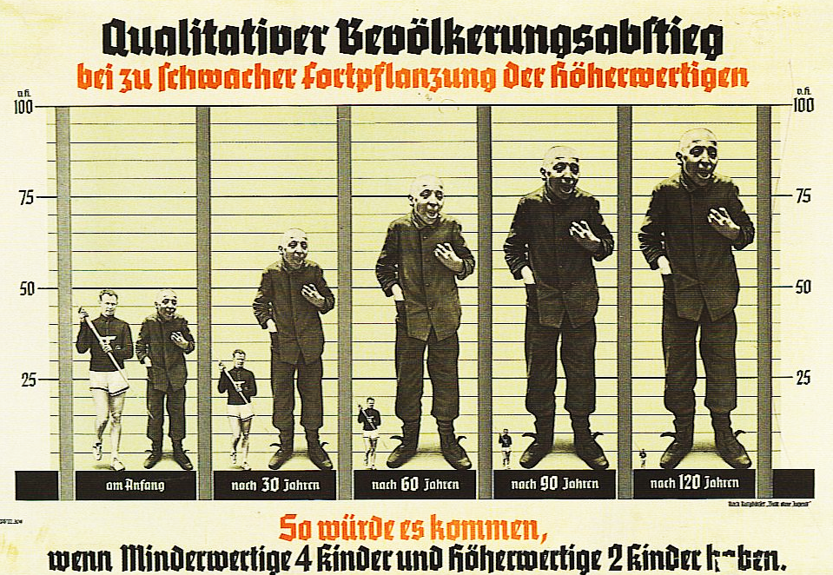
Eugenics
“The Nazi party secures the community.”
“Turn to the community for advice.”
Mother’s Cross
Gold – 7+ kids
Silver – 6 kids
Bronze – 5 kids
Fear of Jews reproducing at a higher rate

